Slide 1
SC1015
ML Disney+ Movie Recommendation System
Kavipooja
Esvaran
Priyadharshiny

Slide 2
Table of Contents
01
02
03
04
05
Problem Statement
Data Preparation
EDA & Visualisation
Machine Learning Techniques
Insights & Recommendations

Slide 3
Problem Statement

Slide 4
How do we build a content-based recommendation system for Disney+ TV shows and movies that accounts for similarities in genre and description?

Slide 5
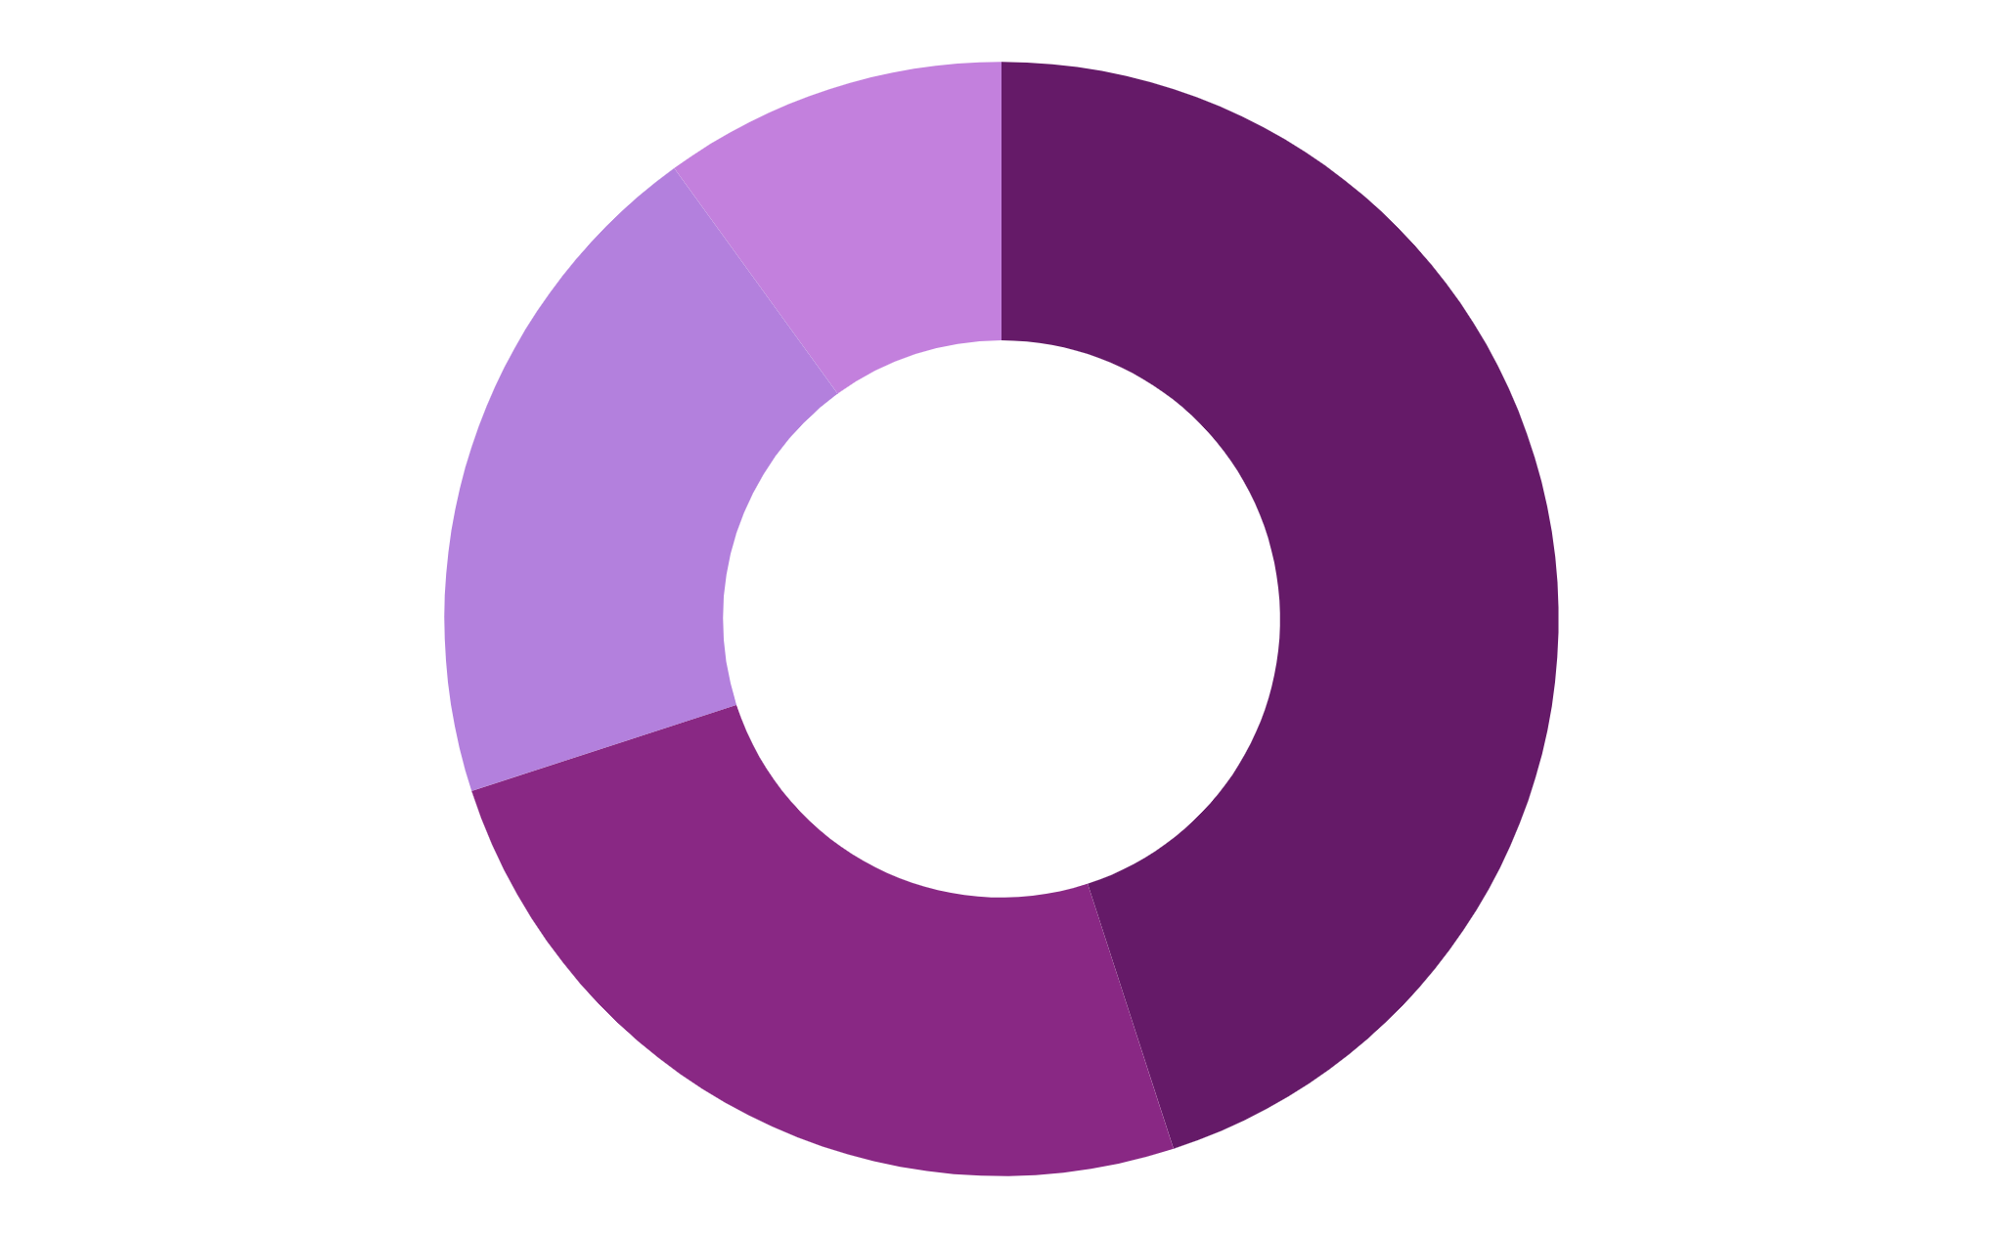
DATA PREPARATION AND DATA CLEANING

Slide 6
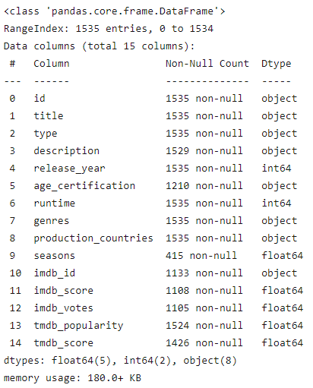
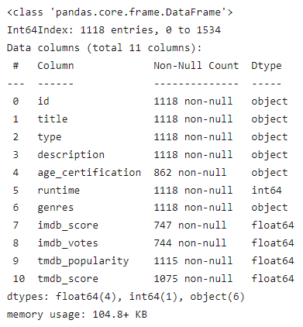
First, let’s clean the data set by removing all the unnecessary columns. This increases the accuracy and quality of the data and reduces the issue of redundancy and memory usage. The characteristics we removed aren’t significant to the recommendation system.
After dropping the columns: ‘release_year’, ‘seasons’, ‘production_countries’, and ‘imdb_id’
Dropping of some duplicates under some variables and also extraction of required variables for data analysis.

Slide 7
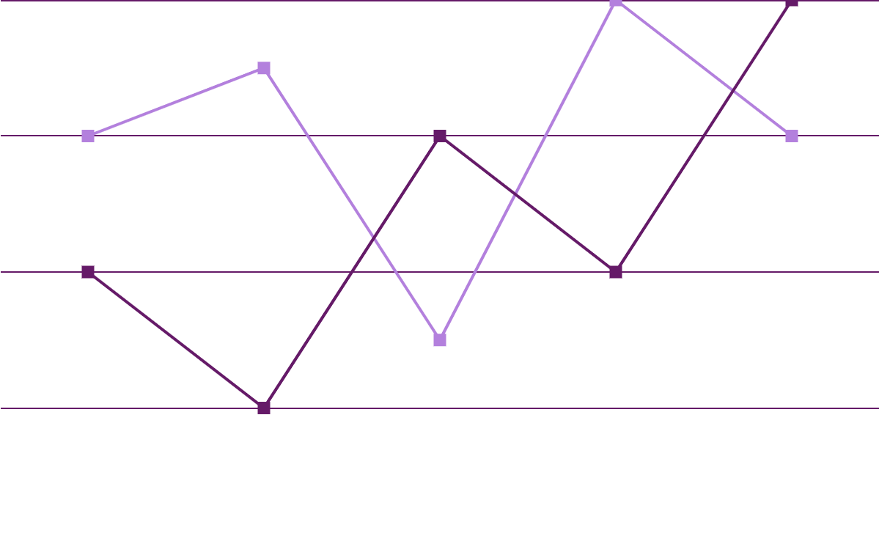
EXPLORATORY DATA ANALYSIS AND VISUALIZATION

Slide 8
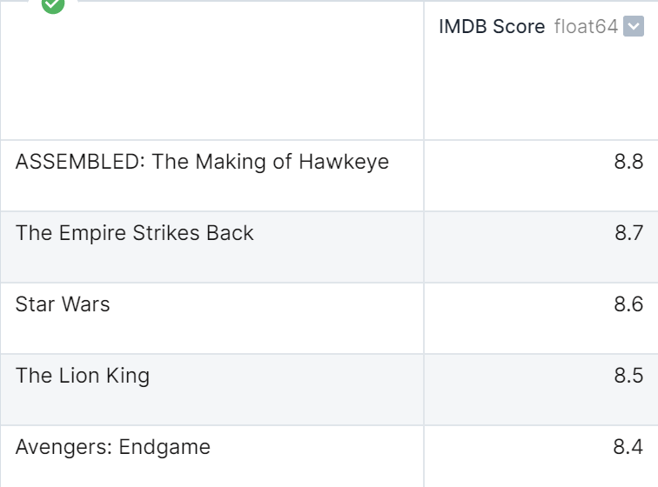
TOP 5 imdb_score
From analysis of the table,
The top movie is ASSEMBLED: The Making of Hawkeye with the highest IMDB score of 8.8.
The top 5 movies range from an IMDB score of 8.4 to 8.8.
Table

Slide 9
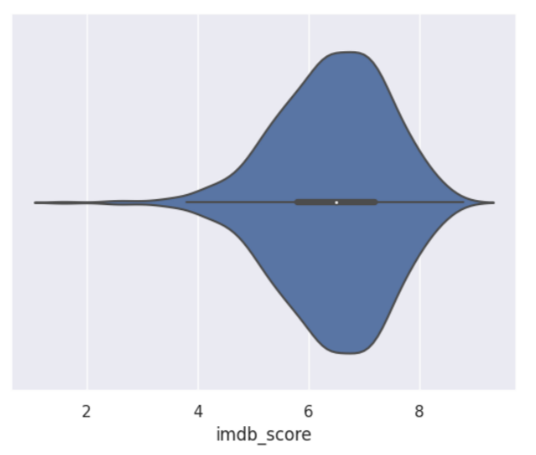
Exploring imdb_score
Violin Plot - illustrate the density of data at different values
From the violin plot,
The ratings that have the highest frequency lie between 6 and 8.
The ratings that have the lowest frequency lie between 4 and 6.
Violin Plot

Slide 10
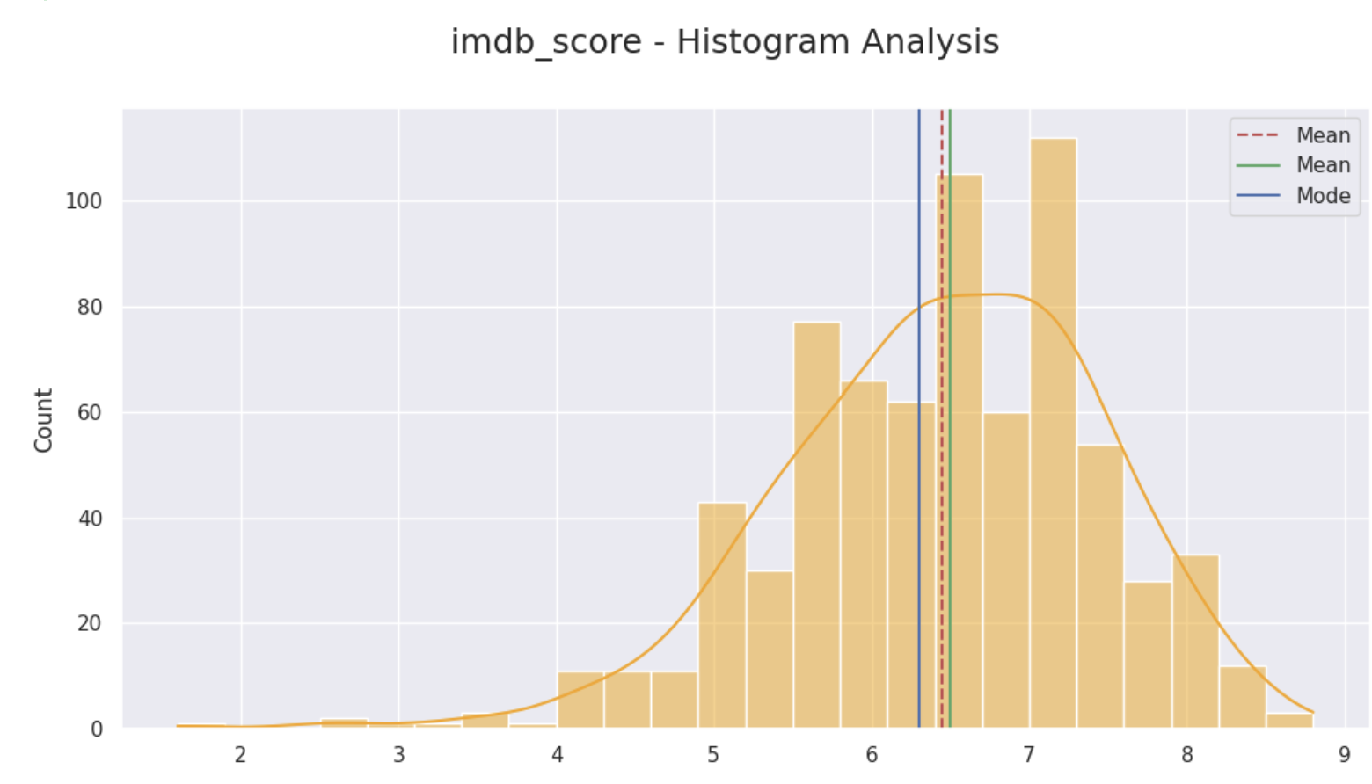
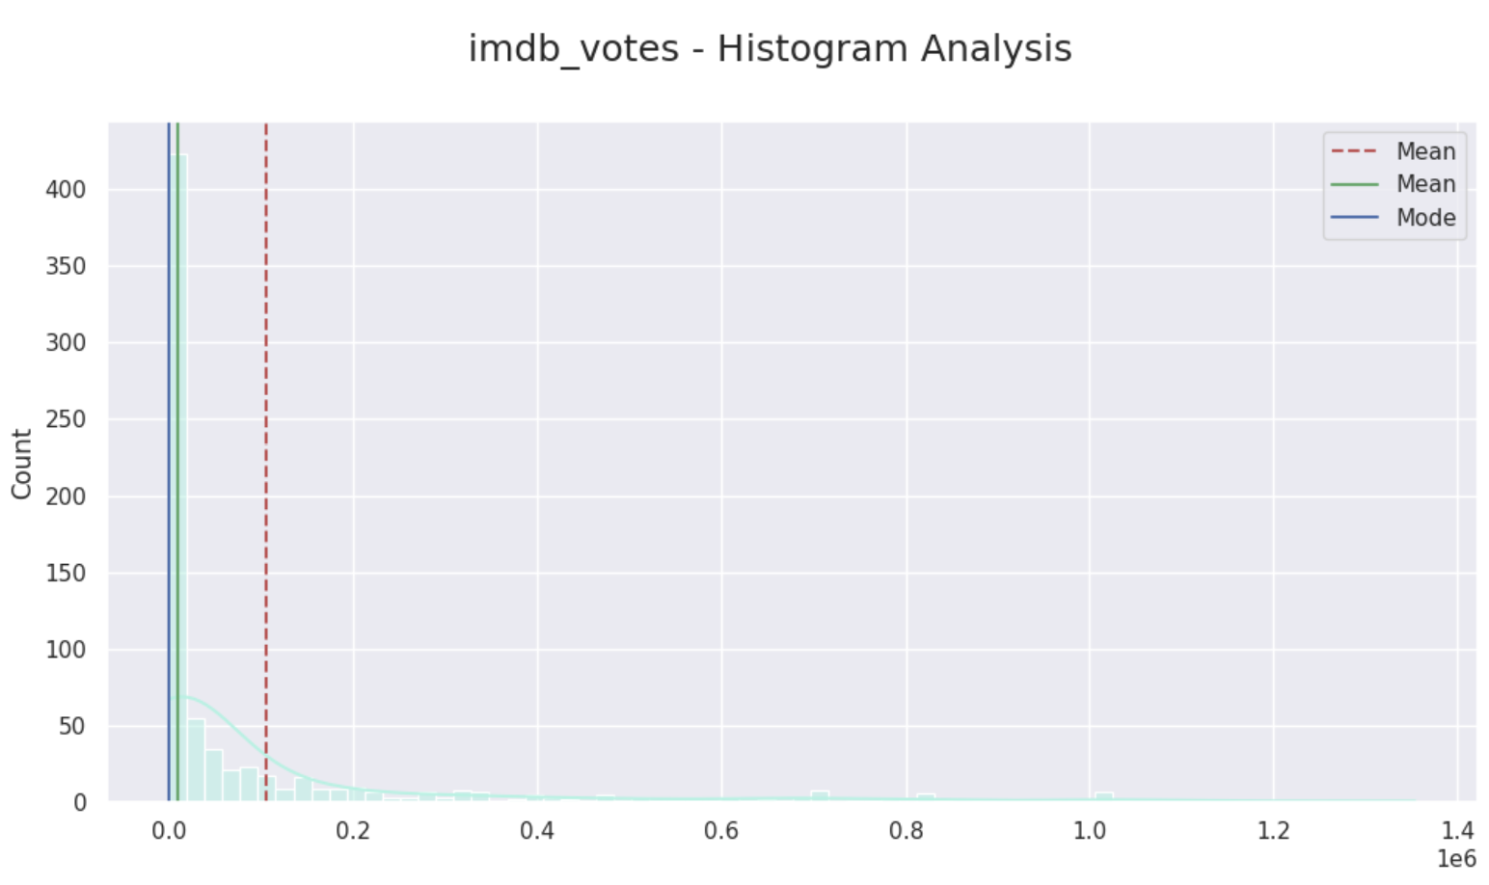
Analysis of central tendency across variables
Histogram Plot - provides a visual representation of distribution of data
From the histplot, showing the central tendency of the data we are able to identify the:
distribution of data
the mean, median & mode
Variables: imdb_score, imdb_votes, tmdb_popularity and tmdb_score.
Histogram

Slide 11
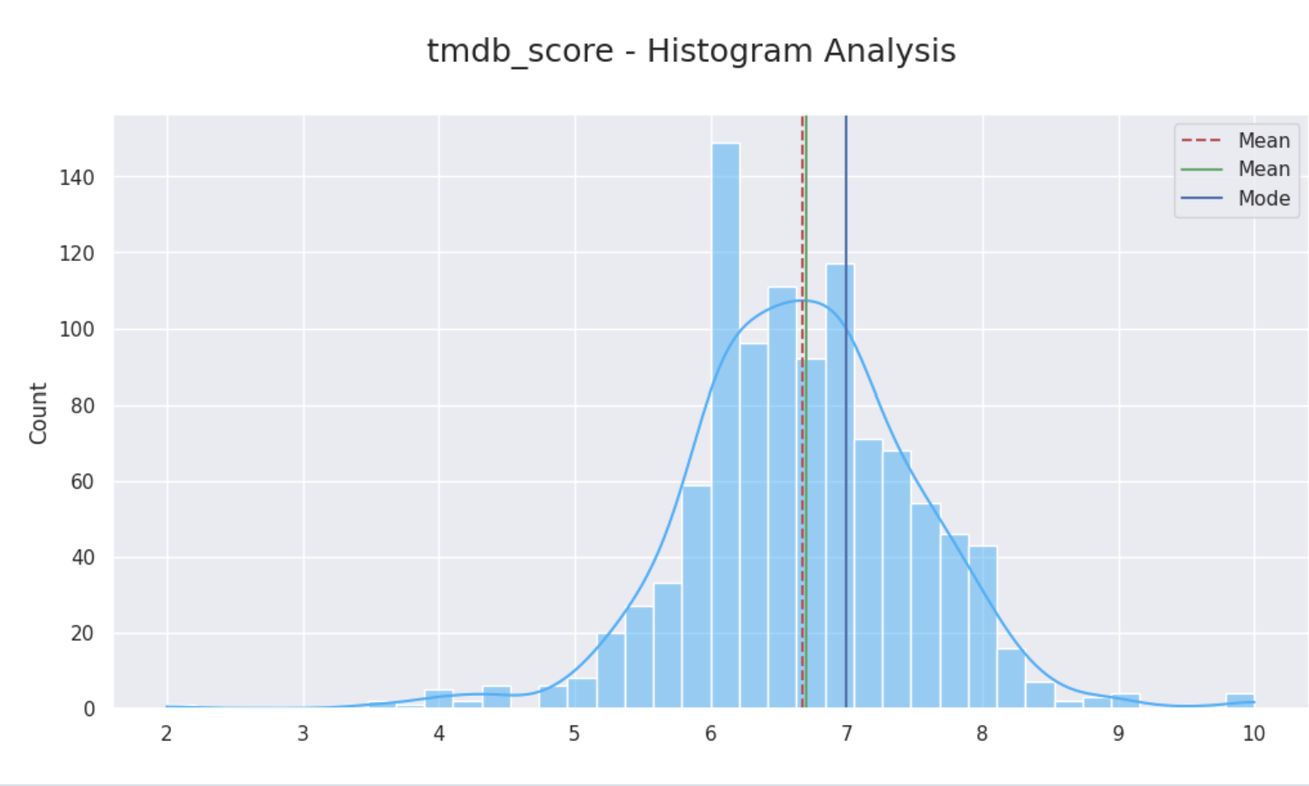
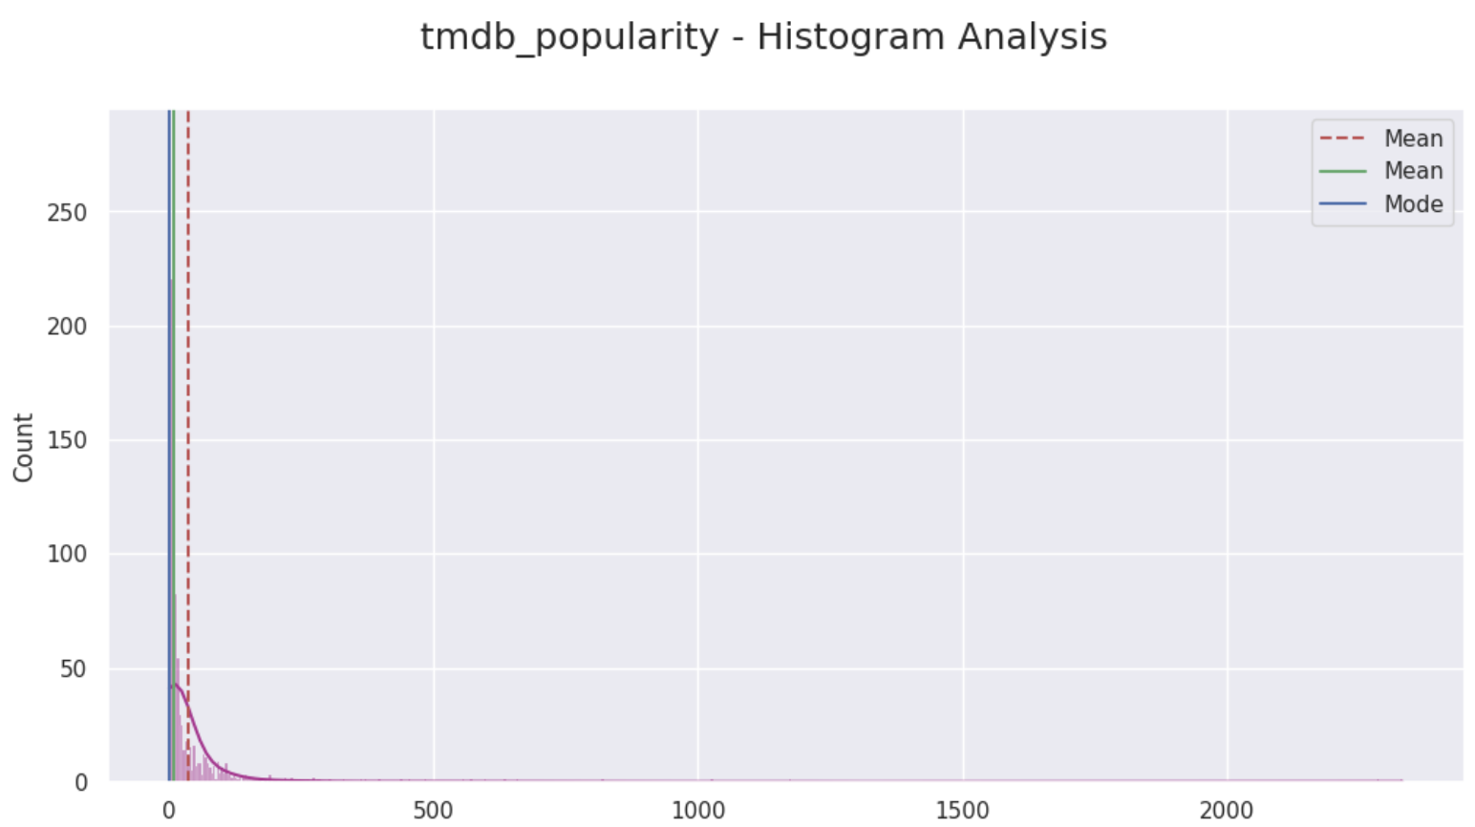
Analysis of central tendency across variables
Histogram Plot - provides a visual representation of distribution of data
From the histplot, showing the central tendency of the data we are able to identify the:
distribution of data
the mean, median & mode
Variables: imdb_score, imdb_votes, tmdb_popularity and tmdb_score.
Histogram

Slide 12
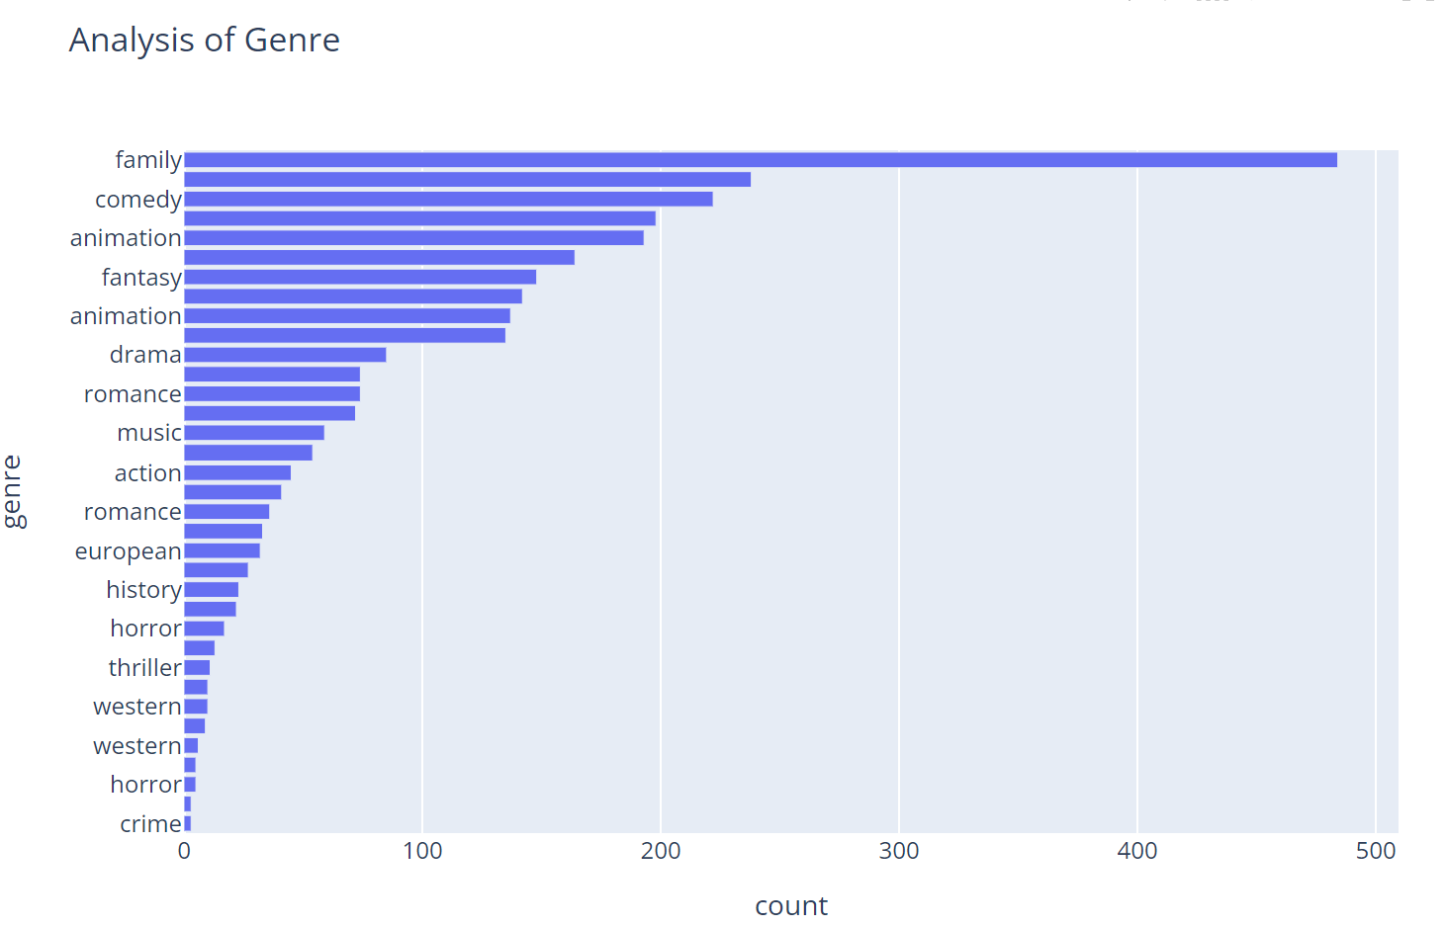
Exploring genre
From the Barchart plot (ordered from most to least popular genre, in descending order )
The most popular genre is "family" with a count of 484.
"comedy", "animation", "fantasy" fall as the next three genres after "family".
The least popular genre is "crime" with a count of 3.
Bar Chart Plot

Slide 13
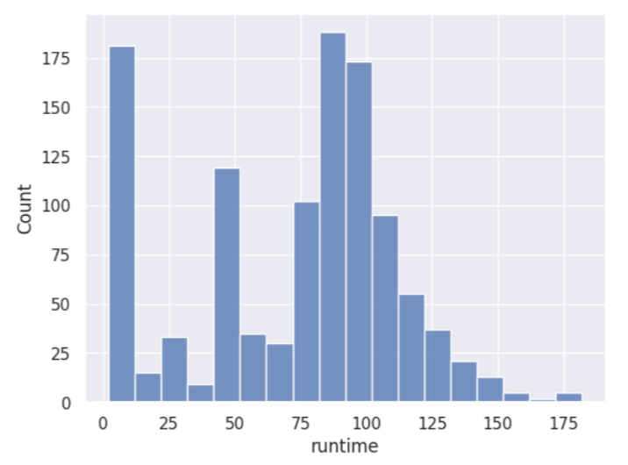
Exploring runtime
Histogram Plot - provides a visual representation of distribution of data
From the histogram plot,
(The runtime of the movies are given in terms of minutes.)
More than 175 movies have a runtime that is above 87 and below 100.
Next to that, close to 175 movies have a runtime that is between 0 and 12.
Movies whose runtime is between 150 and 175 are the ones which are lower in frequency.
Histogram Plot

Slide 14
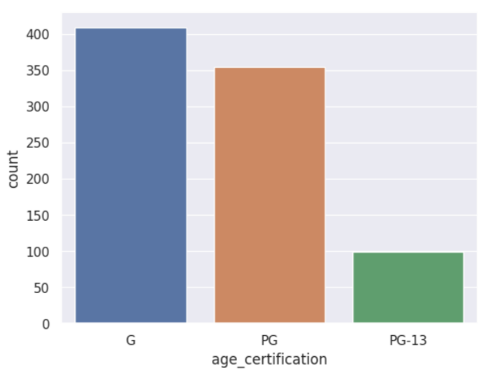
Exploring age_certification
Count Plot - frequency of categorical values can be identified.
From the count plot,
Almost 100 movies are categorized under PG-13.
Almost 350 movies are categorized under PG.
Almost 400 movies are categorized under G.
Count Plot

Slide 15
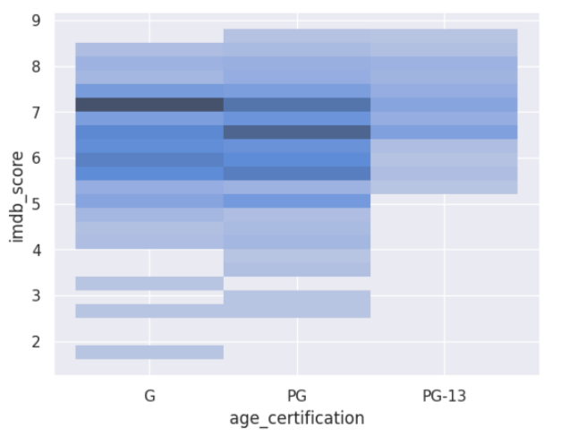
Exploring the relationship between imdb_score and age_certification
Hist Plot with Heatmap - 2-D space that provides an illustration of the relationship between two variables and shows the most concentrated observations.
e Hist Plot with Heatmap,
It is evident that movies with an age certification of G have a greater imdb_score compared to the others.
This trend is observable as there is a larger concentration of color at that section.
Next to that, a higher imdb_score has been observed for PG that is between 6 and 7 and slightly above 7.
Bivariate Hist Plot with Heatmap

Slide 16
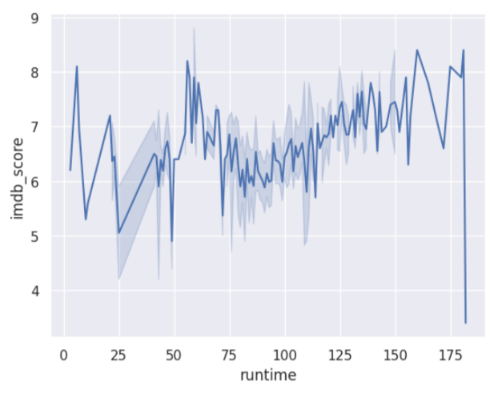
Exploring the relationship between runtime and imdb_score
Line Plot - show how a variable changes periodically and how one variable is influenced by another.
From the Line Plot,
There is an evident relationship between imdb_score and runtime.
It's clear that movies with a runtime between 150 and 175 minutes have a higher imdb_score.
Similarly, movies with a runtime between 0 and 25 minutes and between 50 and 75 minutes have a higher imdb_score.
Line Plot

Slide 17
MACHINE LEARNING TECHNIQUES

Slide 18
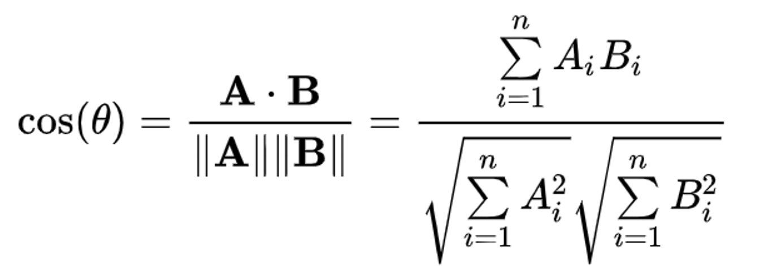
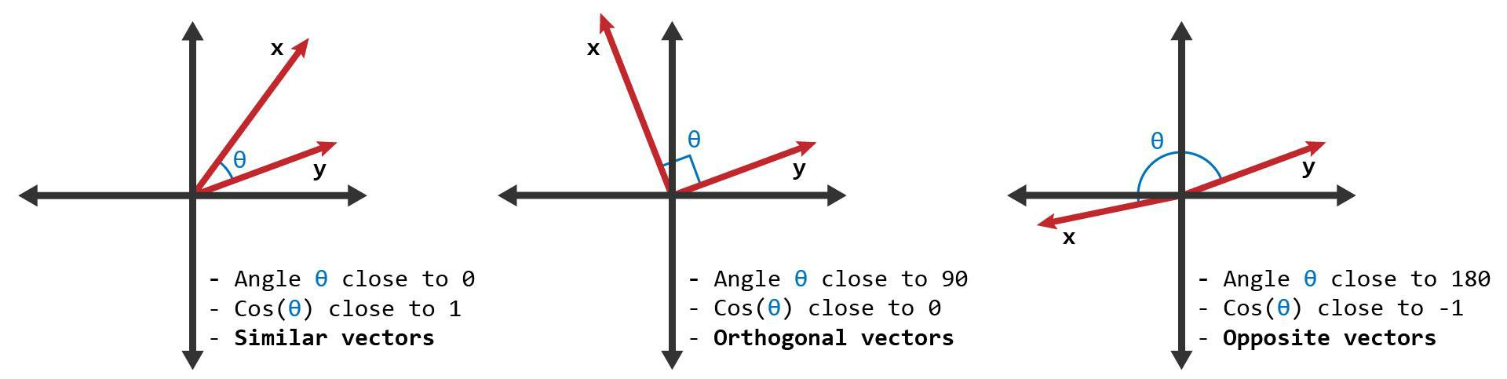
Vectorization Techniques
Document Similarity is one of the key metrics involved in textual analysis, and it represents the foundation for our recommendation system.
Understanding Cosine Similarity
Textual Analysis

Slide 19
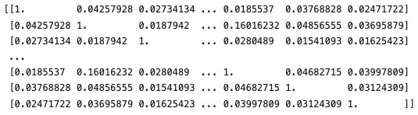
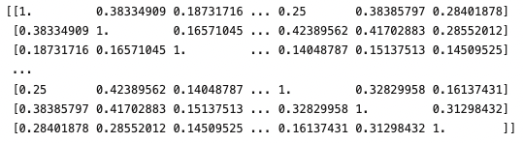
TF-IDF Vectorizer
Count Vectorizer
Increases the importance of a particular word w if it's unique to a movie's description, thereby decreasing the significance of common words, such as 'a', 'the', 'and', etc.
Denotes the frequency of each word within the description, providing equal importance to all words, including common occurrences.

Slide 20
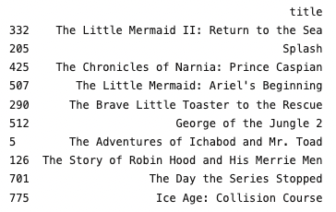
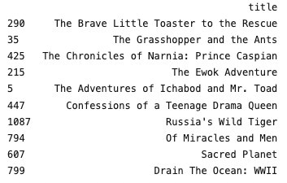
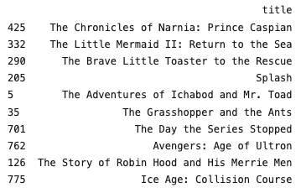
Comparison Between Vectorizers
The purpose of constructing different matrices is to illustrate how recommendation systems can vary vastly depending on the mechanism we utilize to assign importance to words within the string.
Only TF-IDF
Only Count
TF-IDF + Count
Recommendations Based on The Little Mermaid

Slide 21
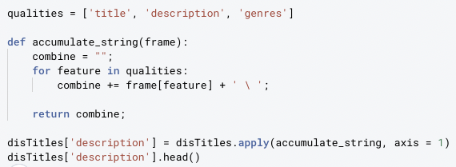
Recommendation System
Using the TF-IDF vectorizer, we're going to develop our final recommendation system that'll account for certain characteristics we didn't previously acknowledge.
In addition to analyzing the description, we'll account for the movie title (for recommending sequels) and the genre. This will permit the system to make higher-quality recommendations that consider the user's interests as well.

Slide 22
INSIGHTS AND RECOMMENDATIONS

Slide 23
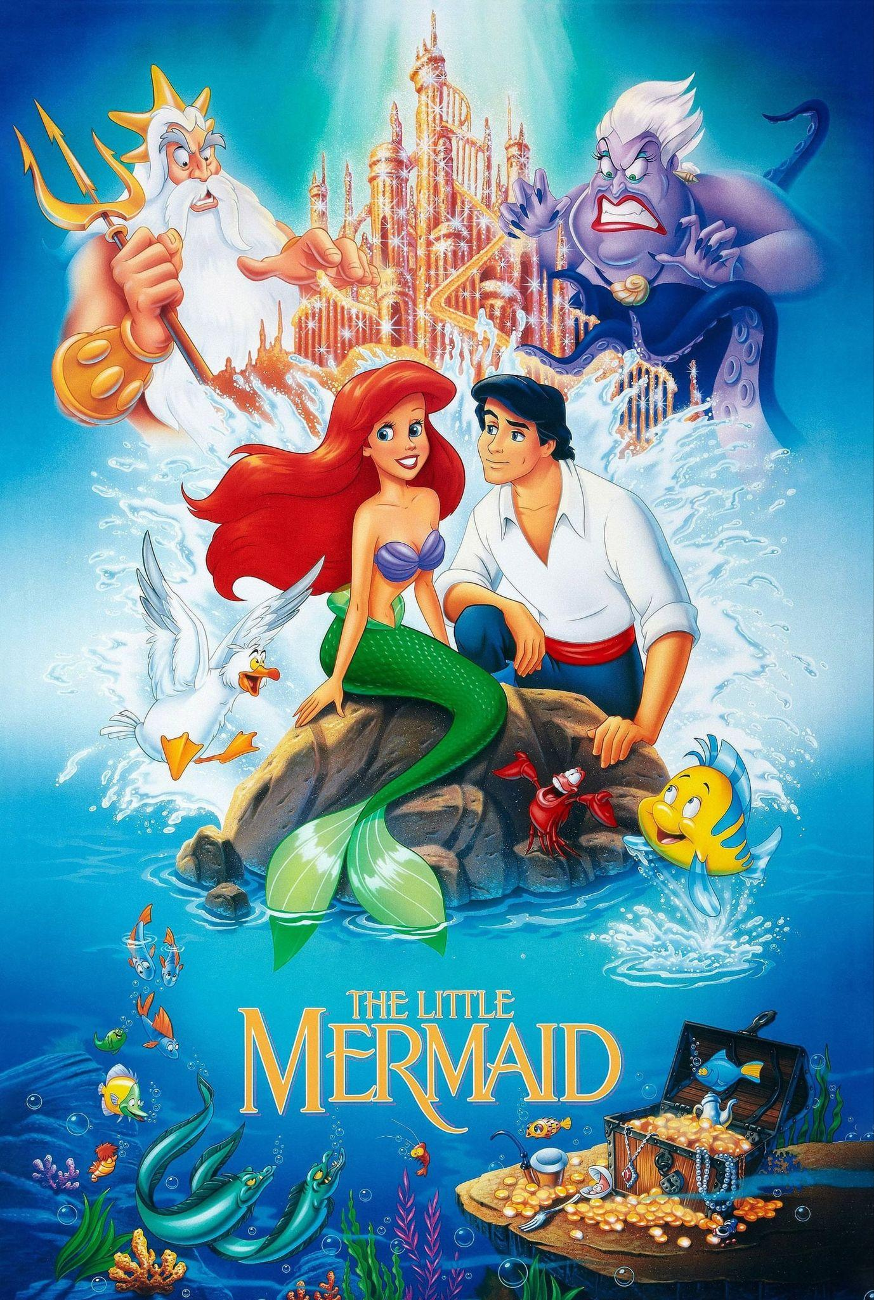
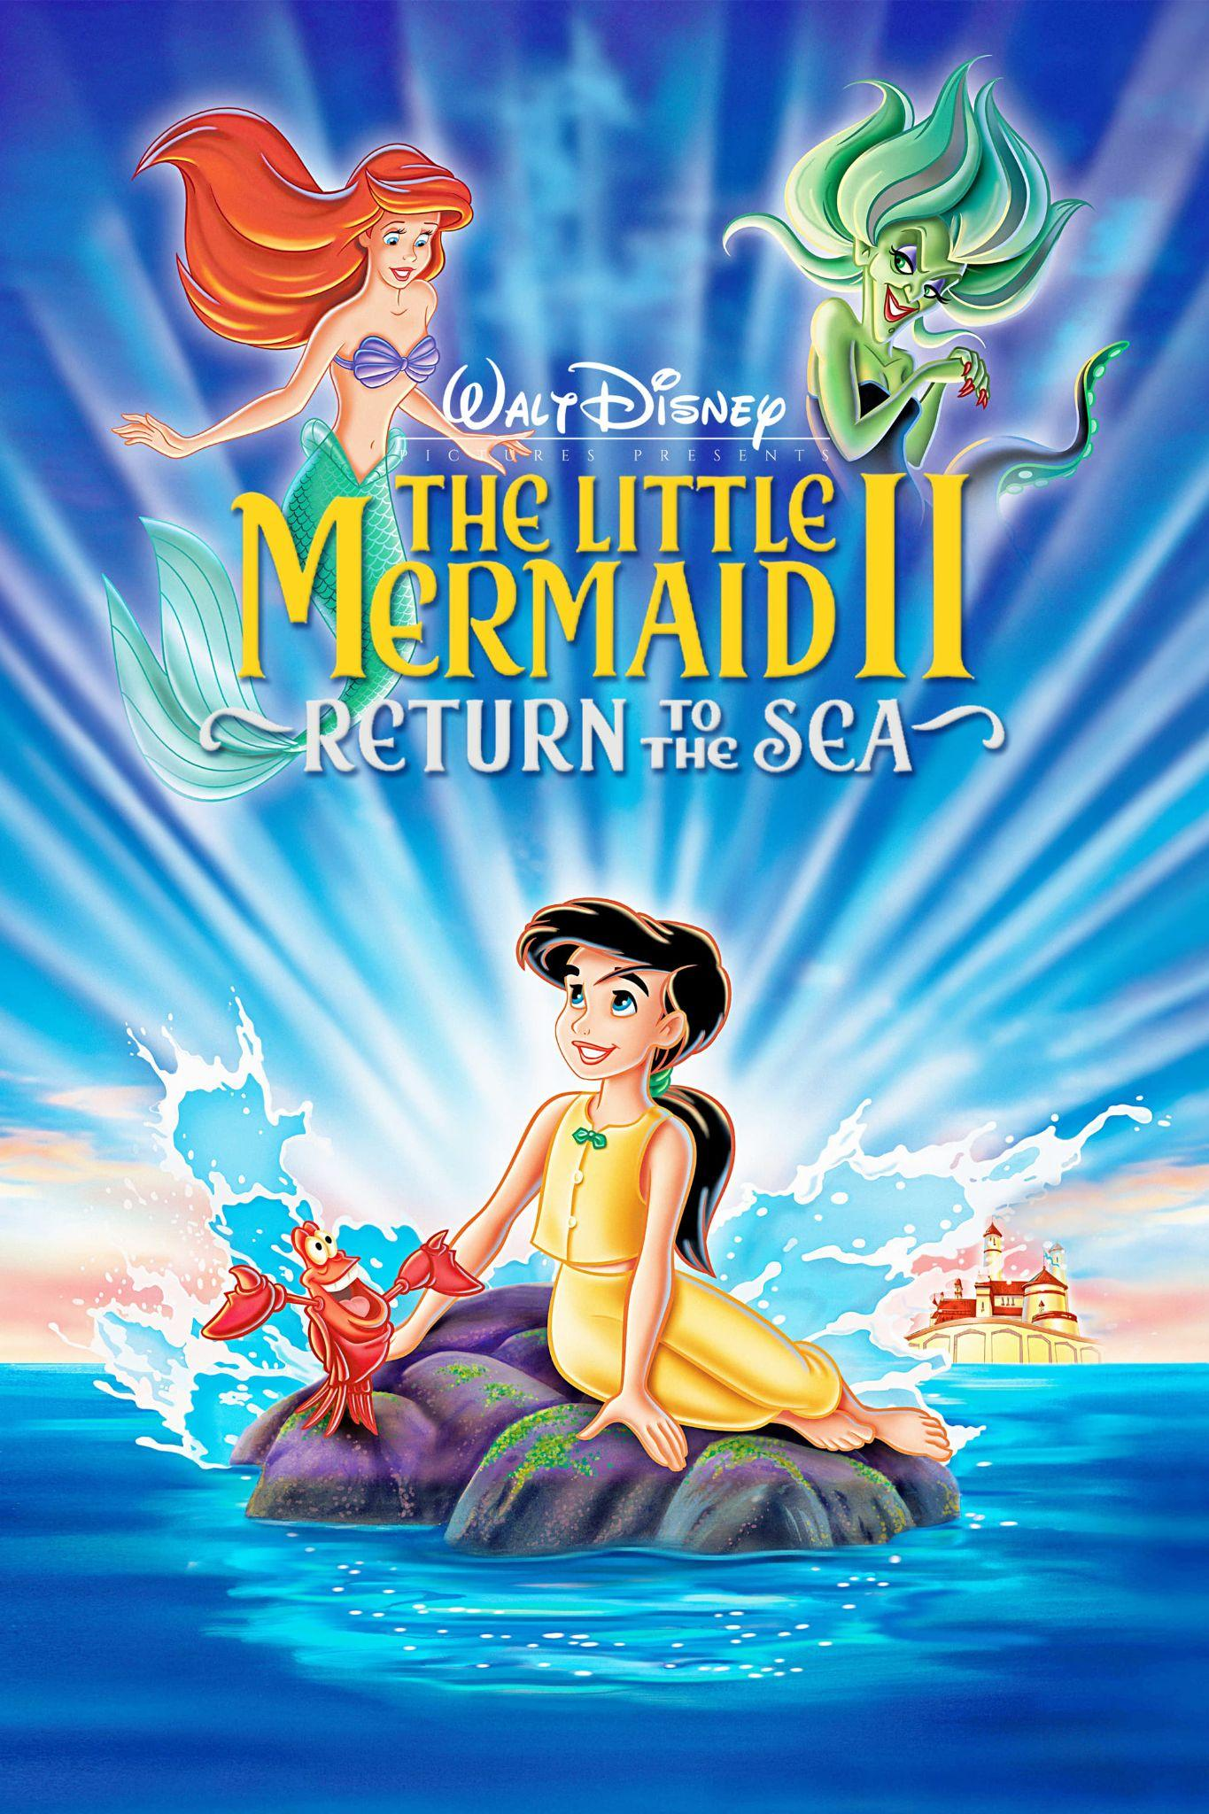

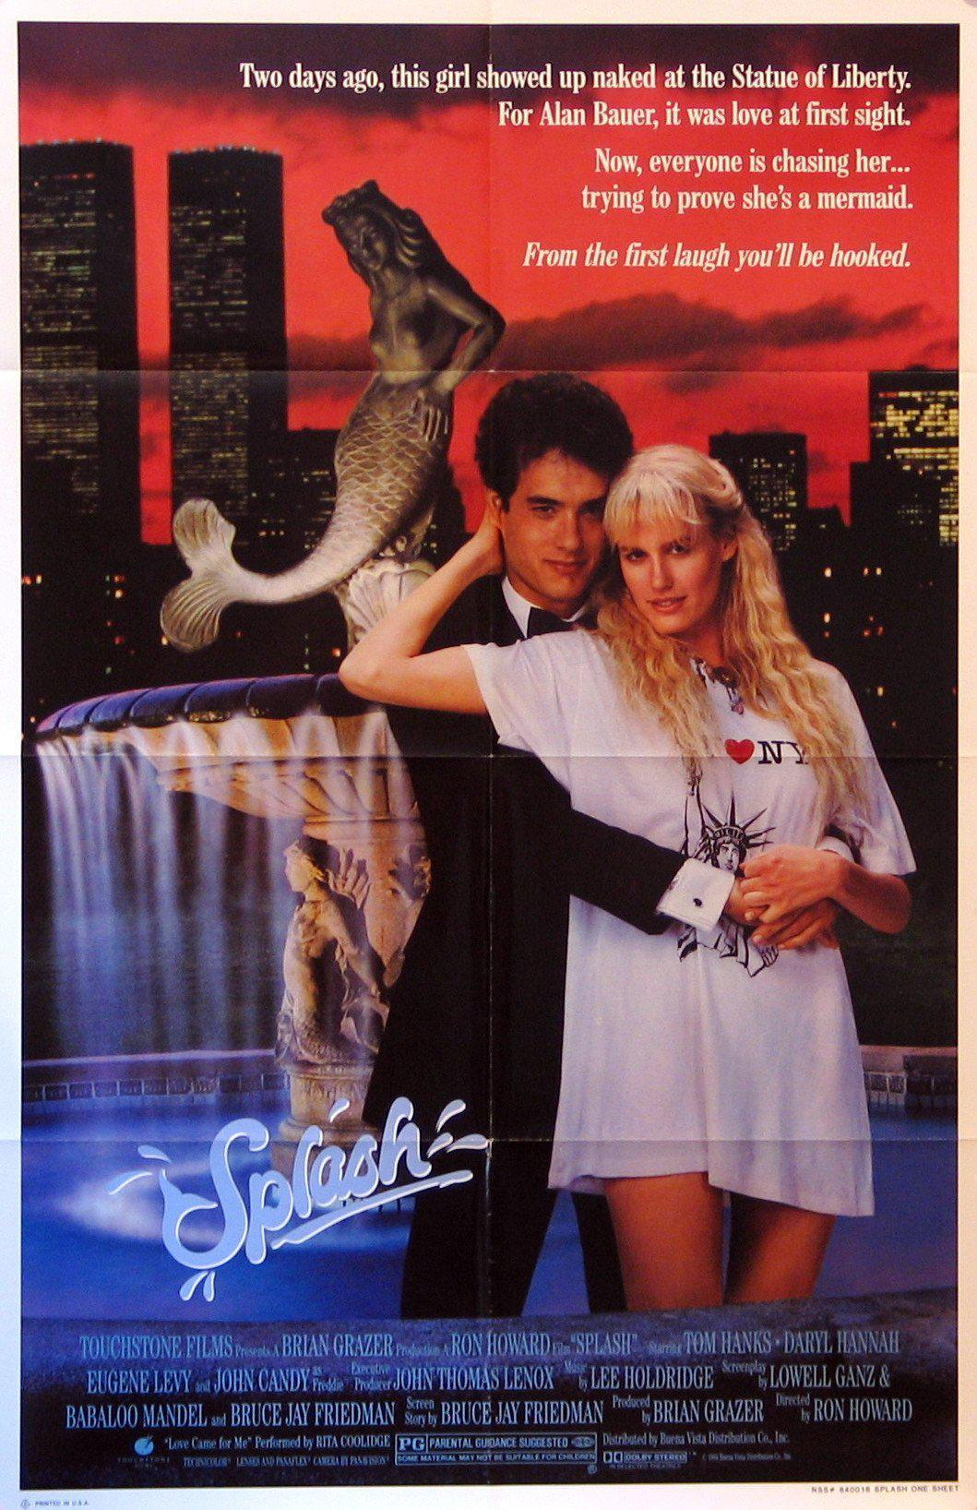
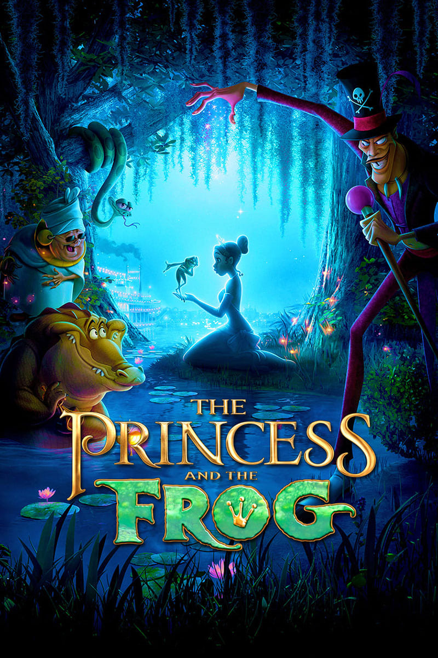

Slide 24
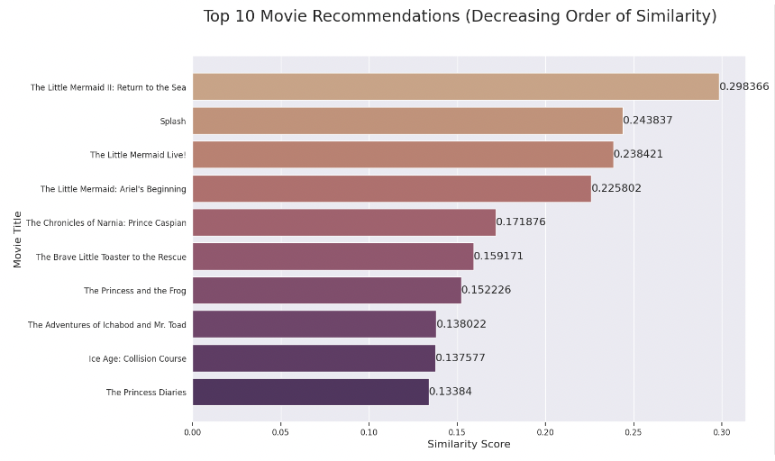
Similarities of Our Final Recommendations

Slide 25

Collaborative Filtering
Content-based filtering (our approach) accounts for the characteristics of the film, including its description, genre, and actors; however, it fails to represent the user's preferences. In order to address these restraints, we introduce a higher-level approach called collaborative filtering, which accounts for similarities between users as well.

Slide 26
Accounting for User’s Preferences
Genres User Likes
Favorite Actors
Trending Films
We can filter out films that aren't within the scope of the search space, eliminating choices that the user won't appreciate anyways.

Slide 27
Thank You!

